Slide 1



Sales Data Analysis

Slide 2
Crop Production Analysis in India

Slide 3

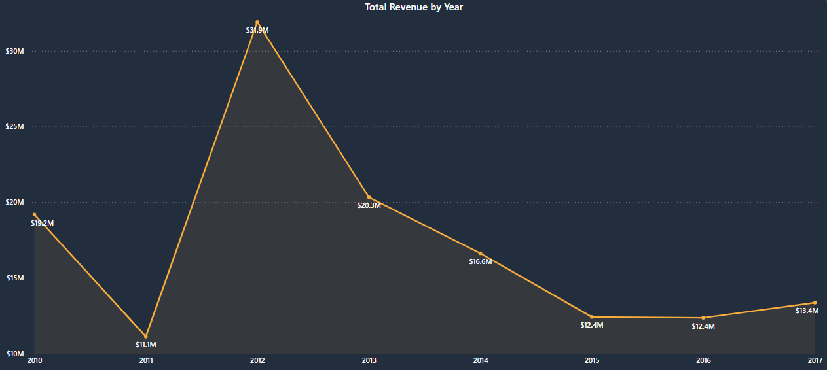
Problem Statement
As a vital part of the overall supply chain, the Agriculture business domain is expected to evolve highly in the upcoming years via the developments, which are taking place on the side of the Future Internet. This paper presents a novel Business-to-Business collaboration platform from the agri-food sector perspective, which aims to effectively and flexibly facilitate the collaboration of numerous stakeholders belonging to associated business domains. This dataset provides a huge amount of information on crop production in India over several years. Based on the Information the ultimate goal would be to predict crop production and find important insights highlighting key indicators and metrics that influence crop production.

Slide 4

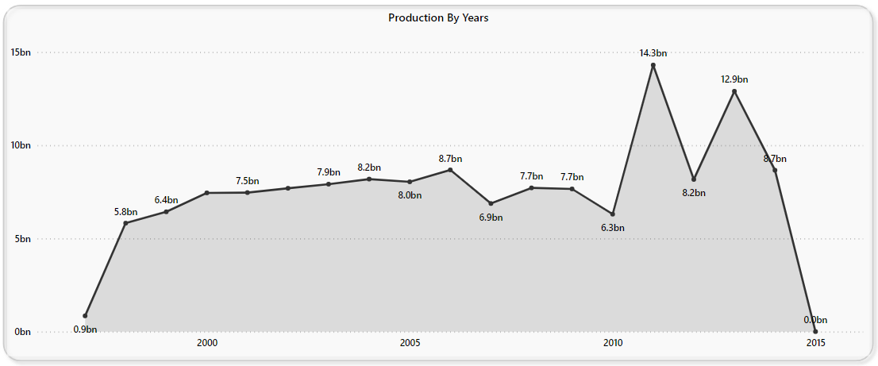

Production by Years
1995: Production was 850 million units.
2011: Production increased to 14.3 billion units, representing a 1,582% increase from 1995.
2014: Production decreased to 8.66 billion units, reflecting a 39.44% decrease from 2011.

Slide 5

Key Metrics
141bn+
2.90bn+
100+
Total Production
Total Area
Crop Types
The overall quantity of harvested crops over a specific period includes grains, vegetables, fruits, and other plant-based products.
Total area for agriculture, residential, commercial, and industrial activities, including farming, urban development, infrastructure, and natural reserves.
This includes grains (e.g., rice, barley), fruits (e.g., bananas, coconuts), vegetables (e.g., tomatoes, potatoes), and others (e.g., sugarcane, cotton, and bajra).
42
6
Average Production/Unit Area
Seasons
The overall yield of crops is the amount harvested per unit of land area, typically measured in weight per hectare or acre. This metric reflects agricultural productivity and farming practices.
A diverse range of agricultural products is cultivated across distinct growing seasons, including crops that grow year-round.eg Autumn, Summer, Kharif, Rabi, Winter, and crops that grow the whole year

Slide 6
Production by Season
Production by State
Production by District
Kerala:
Kozhikode:
Whole Year:
Total Production: 97.88 billion
Highest producer of crops
Total Production: 15.28 billion
Highest producer of crops
Total Production: 134.42 billion
Highest production throughout the year Mostly Coconut
Andhra Pradesh:
Malappuram:
Kharif Season:
Total Production: 17.32 billion
Second highest producer of crops.
Total Production: 14.52 billion
Second highest producer of crops
Total Production: 4 billion
Second-highest production
Tamil Nadu:
Thiruvananthapuram:
Rabi Season:
Total Production: 12 billion
Third highest producer of crops
Total Production: 10 billion
Third highest producer of crops
Total Production: 2 billion
Third-highest production

Slide 7
Production by Seasons
Autumn Season:
Kharif Season:
Total Production: 64 million
Highest Producer: Rice (51 million)
Second Highest: Maize (8 million)
Third Highest: Paddy (2 million)
Total Production: 4 billion
Highest Producer: Sugarcane (1.77 billion)
Second Highest: Rice (1 billion)
Third Highest: Cotton (281 million)
Rabi Season:
Whole Year:
Total Production: 2 billion
Highest Producer: Wheat (1.32 billion)
Second Highest: Potato (200 million)
Third Highest: Gram (95 million)
Total Production: 134 billion
Highest Producer: Coconut (129 billion)
Second Highest: Sugarcane (3.75 billion)
Third Highest: Potato (200 million)

Slide 8
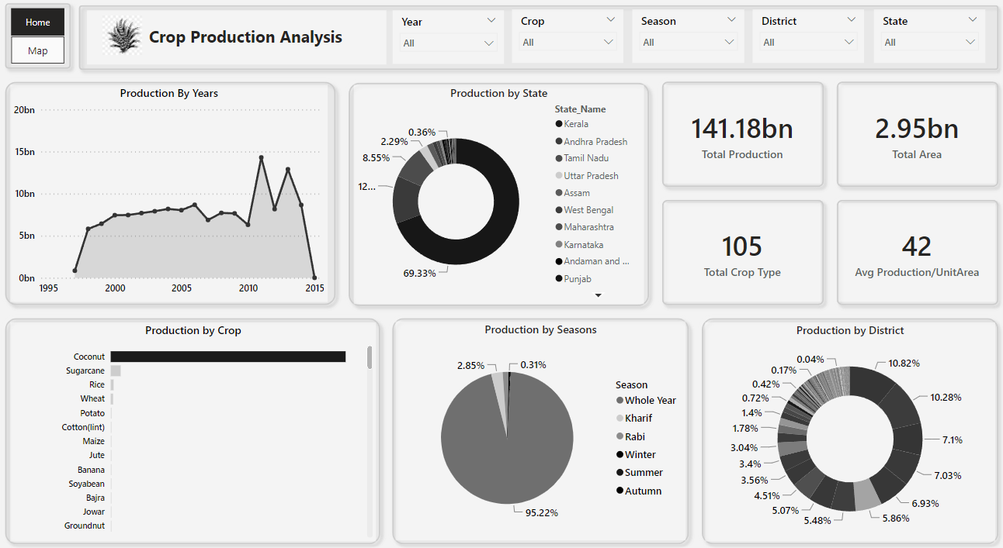

Slide 9
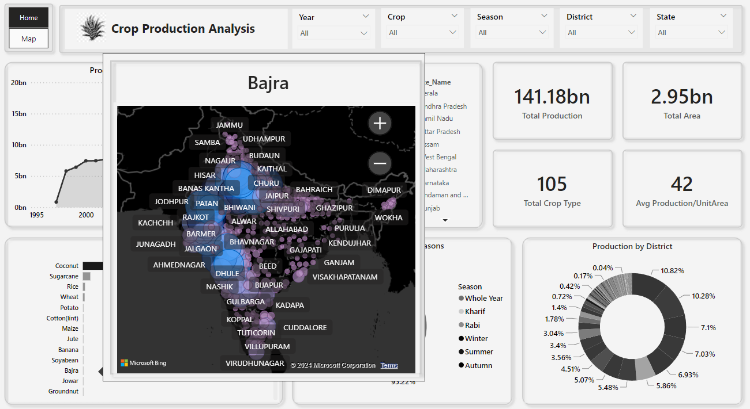

Slide 10
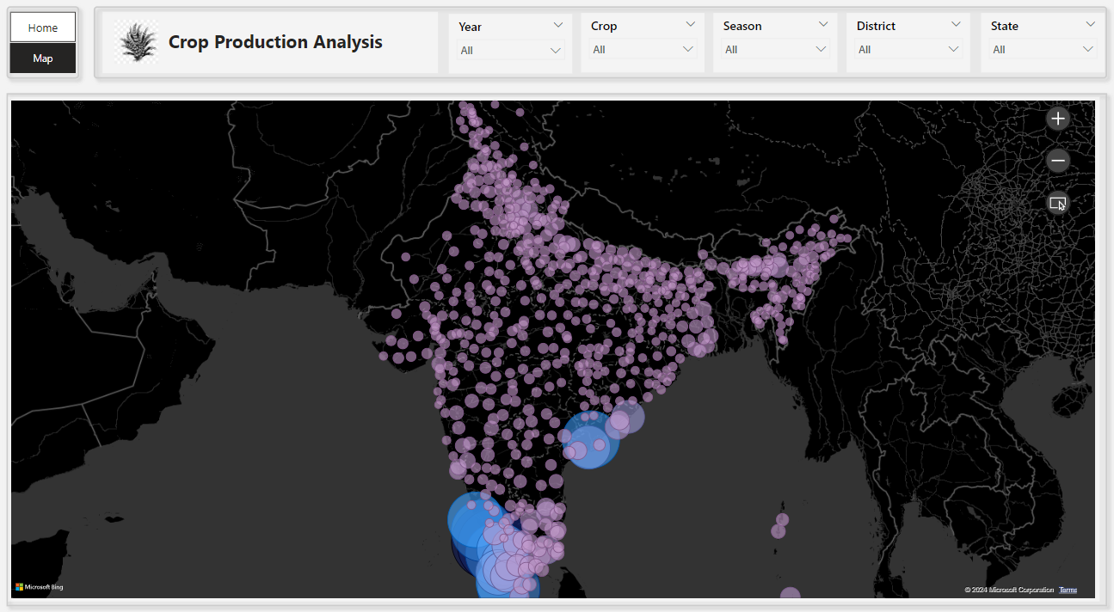

Slide 11
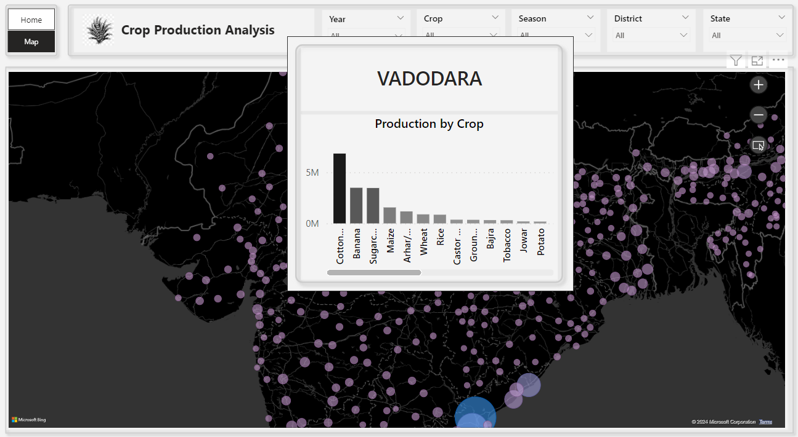

Slide 12

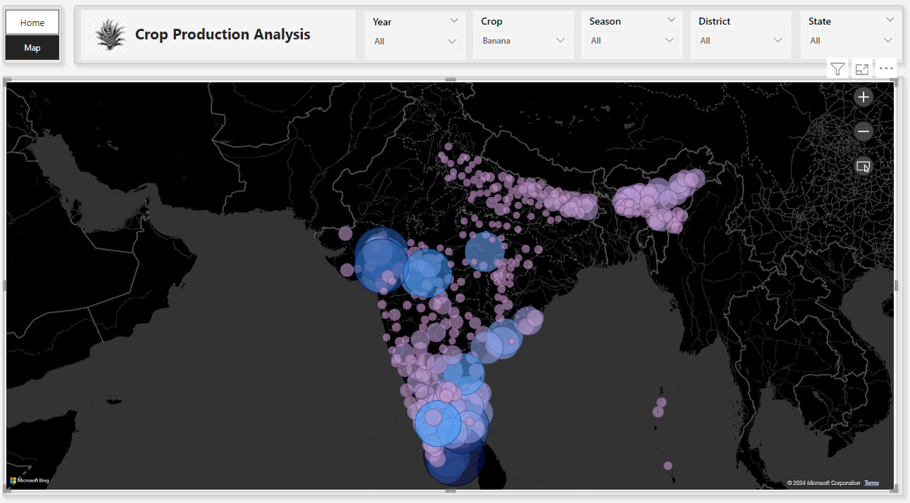
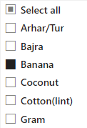

Slide 13
Conclusion
Diversification: Explore diversifying crops to balance production across seasons and reduce dependency on a few key crops.
Technology Integration: Utilize advanced agricultural technologies and practices to boost yields for the highest-producing crops.
Resource Management: Improve resource allocation and management to enhance production efficiency for lesser-producing crops.
Market Analysis: Conduct regular market analysis to align production with demand trends and optimize profit margins.
Sustainability Practices: Implement sustainable farming practices to maintain long-term production capacity and environmental health.

